Slide 1
Classes & objects
JC08-2.1
(A. Nguyen)

Slide 2
Class vs. object
A class represents a category of objects that share common characteristics and behaviors; it is a blue print for all objects in that class
For example,
a class many be BankAccount
an object of that class may be momsAccount

Slide 3
The Java Library
The Java Library is a collection of classes that are available for Java programmers to use
Some examples:
Class PrintStream provides the printing capabilities (println, print), etc.
Class JOptionPane provides functionality with dialog windows, etc.
Class String provides functionality with handling pieces of text
To see what is available and how to use, search “Java API” on the Internet
API stands for Application Programming Interface

Slide 4
The API
Programmers consult the Java API when using the Java Library
Programmers’ own classes can be “automatically” documented in the same manner, including documentation within symbols /** … */, called Javadoc documentation – you can easily switch between the source code and the documentation in BlueJ
Thanks to the Javadoc documentation, past & present & concurrent programmers can “show” one another how to use their own classes

Slide 5
The PrintStream class
The PrintStream class provides the “printing” functionality to the console window, where the parameter/input may be of type String or int, etc.
System.out is an object of the PrintStream class
PrintStream has a method called println (& print, etc.), which can be called by any object of the PrintStream class
To invoke/call the method, we write the object name, a period, the method name, and possibly the parameter(s) in parentheses; e.g.,
System.out.println(“Hello”);

Slide 6
The String class
The String class represents a sequence of text, with various methods/functionalities relating to manipulating the text
Some functionalities are: finding certain (smaller) sequence of text, extracting (smaller) sequence of text, etc.
When a programmer writes a piece of text in double quotes in a Java program, a String object is automatically created to represent that text

Slide 7
The Scanner class
The class PrintStream provides the functionality to display the output to the console window; the Scanner class provides the functionality to accept input from the user (from the keyboard, etc.)
In preparing the keyboard for input, a programmer creates a keyboard object:
Scanner kboard = new Scanner(System.in);
When done, the programmer writes:
kboard.close();
In between these two statements, the programmer can accept inputs from the user, of various data types (text, integer, etc.)

Slide 8
The Scanner class (cont.)
After the keyboard object, called kboard, is created, the programmers use the following statements to accept inputs from the user:
String name = kboard.nextLine(); // Get text & save in name
int age = kboard.nextInt(); // Get integer & save in age
double dist = kboard.nextDouble(); // Get floating-point # & save in dist
Note that, before accepting the user’s input, you must remember to ask/request with System.out.print(“…”);
Certain library classes (e.g., String) are automatically included in a Java program. The Scanner class is not. Therefore we must import it, before the class header: import java.util.Scanner;

Slide 9
Variables
JC08-2.2
(A. Nguyen)

Slide 10
Data types
There are two kinds of data types: classes/object and primitive data types
In the following statements:
String name = kboard.nextLine(); // Get text & save in name
int age = kboard.nextInt(); // Get integer & save in age
double dist = kboard.nextDouble(); // Get floating-point # & save in dist
… name is an object of the String class
… age is a variable of primitive data type called int
… dist is a variable of primitive data type called double

Slide 11
Data types (cont.)
The classes come from the Java Library (e.g., String, Scanner, etc.), and also from creation by programmers/you (e.g., HelloPrinter, etc.)
There are 8 primitive data types: int, double, boolean, char, byte, short, float, long
Different data types need different amounts of RAM space
Note that String is a class; char is a primitive data type:
String firstName = “Abraham”; // in double quotes
char lastInitial = ‘L’; // in single quotes

Slide 12
Variable names
A variable is a piece of RAM space where we store some data.
A variable name:
May contain letters and numbers and underscore (_); no space or special characters – Names are case-sensitive: variable area is NOT variable Area
Must start with a letter, in camel case
Should be meaningful, and cannot be a reserved word (like int, etc.)
Good variable names: firstName, score1, score2
Bad variable names:
6pack – syntax error: name cannot start with a number
stuff – bad style/convention: name is not meaningful
car color – space not allowed; use carColor

Slide 13
Declaration
A declaration is a request for some RAM space
Example:
int numOfYrs; // request RAM space for primitive data type int
String firstName; // request RAM space for an address (or reference) of String class
A variable must be declared before being used
A local variable (i.e., of the same name) cannot be declared more than once – syntax error

Slide 14
Assignment
After a variable is declared, we can assign a value to it (using the equal sign):
numOfYrs = 10;
Note that this equal sign does NOT mean “equal” as in math; it means “is assigned to” or “gets/has the value of”
Later in the code, the variable may be assigned to another value (do not declare it again):
numOfYrs = numOfYrs * 2; // double the # of years
A declaration and an assignment may be combined into 1 statement:
int numOfYrs = 10;

Slide 15
Assignment (cont.)
After a variable is declared, we can assign a value to it (using the equal sign):
Note that this equal sign does NOT mean “equal” as in math; it means “is assigned to” or “gets/has the value of”
Later in the code, the variable may be assigned to another value (do not declare it again):
A declaration and an assignment may be combined into 1 statement:
int numOfYrs = 10;

Slide 16
Assignment (cont.)
In an assignment statement, the left side of the symbol must be a variable name; the right side may be one of the following:
numOfYrs = 10; // constant
sumOfInts = 1 + 2 + 3; // arithmetic expression
numOfYrs = initValue; // another variable, previously declared & assigned
age = kboard.nextInt(); // result from a method call
Bad assignment statements:
numOfYrs = “Hello”; // data type of value is not same as data type of variable
1 + 2 + 3 = sumOfInts; // the variable must be on the left
____

Slide 17
Method call
JC08-2.3
(A. Nguyen)

Slide 18
Method signatures
A class has 2 main parts:
Instance variables, aka fields, representing characteristics
Methods, representing behaviors
The API for a class shows both
Each method is documented with the method name, parameters/inputs (inside parentheses), and return value/output
For example, Scanner has one method called nextInt; it takes no parameters (empty parentheses) and returns a value of type int, as shown in the API:

Slide 19


Some String methods
From the Java API:

Slide 20
Calling methods
To call a method (of a class) is to ask the object of that class to carry out the instructions in that method
For example, after creating a Scanner object:
Scanner kboard = new Scanner(System.in);
… we can ask kboard to get the input by doing calling the appropriate method:
String name = kboard.nextLine(); OR
int age = kboard.nextInt();
etc.
Note the syntax: object name, dot, method name, parameters in parentheses (if any)

Slide 21
Calling methods (cont.)
A method may accept parameters/arguments (i.e., inputs) or not. In the method signature, a parameter is expressed with data type & variable name; and parameters are separated by commas. The call to that method must provide appropriates parameters:
int nameLen = name.length(); // no param to String name
System.out.print(“Hello”); // 1 param
A method may return a value (i.e., one output) or not. In the method signature, if it returns a value, the data type is shown; if not, void is shown
int nameLen = name.length(); // with return value
System.out.print(“Hello”); // without return value

Slide 22
Constructing objects
JC08-2.4
(A. Nguyen)

Slide 23
Constructor
A Java program is a “world” of objects that interact with one another
Before an object can exist (to interact), it must be created, which is done with the new operator and a call to the class’s constructor
Example:
Rectangle rect = new Rectangle(5, 10, 20, 30);
A constructor is a special “method” whose purpose is to initialize the instance variables (aka fields) of a newly created object
Just about all objects must be created this way – except the String class: String school = “Cal”; // automatically did “new”
object
constructor
class
“new” operator
Parameters/arguments/inputs

Slide 24
Constructor (cont.)
A constructor’s name is the same as the name of the class and the .java file; class Rectangle is in file Rectangle.java and has constructor Rectangle
Like a method, a constructor may accept parameter(s) or not
The result of new and a constructor call is a newly created object:
new Rectangle(5, 10, 20, 30);
… and you can store it in a variable, like rect:
Rectangle rect = new Rectangle(5, 10, 20, 30);

Slide 25
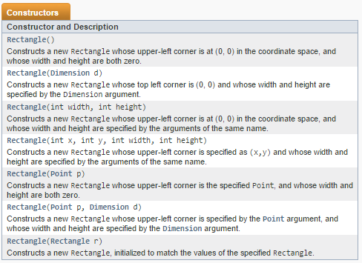
Constructors of class Rectangle

Slide 26
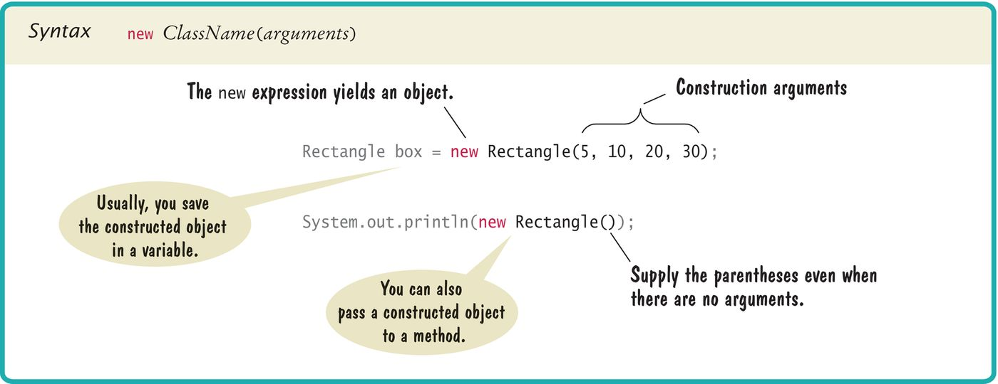
Syntax 2.3 Object Construction
From Java Concepts, 8e, C. Horstmann

Slide 27
Accessors & Mutators
JC08-2.5
(A. Nguyen)

Slide 28
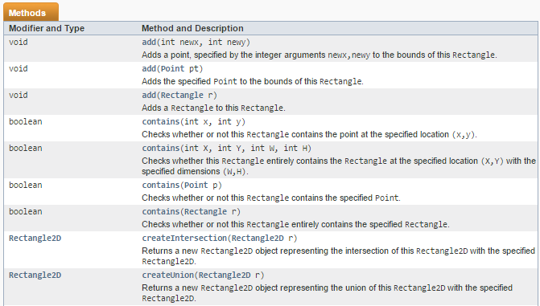
The Rectangle API

Slide 29
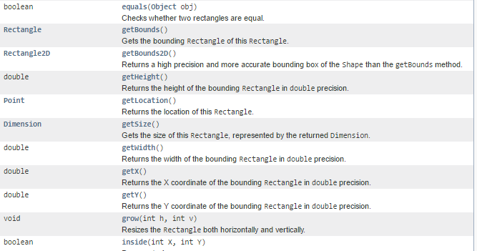
The Rectangle API (cont.)

Slide 30
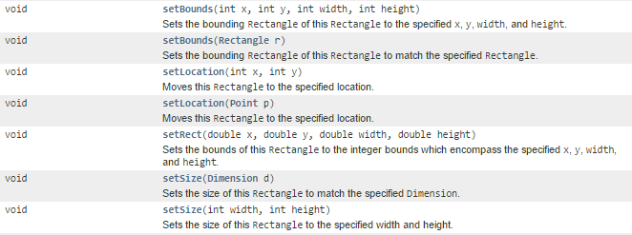

The Rectangle API (cont.)

Slide 31
Accessors
A method is an accessor if it does not change the data.
In the Rectangle class, some accessors are: getHeight, getWidth, getX, getY
An accessor’s name usually starts with get
All String methods are accessors. I.e., when a method is called, the original text is unchanged; the method returns new text

Slide 32
Mutators
A method is an mutator if it changes the data
In the Rectangle class, some mutators are: setHeight, setWidth, setX, setY, setBounds, setLocations, add, grow, translate, union
Some accessors names start with set

Slide 33
Implementing a Tester
JC08-2.7
(A. Nguyen)

Slide 34
Tester
A Tester is a (main) program that is used to test all the methods of a class
When a method returns a value, print it to the console window, along with the “expected” value that you/programmer have calculated to verify
When printing something, remember to start with a label

Slide 35
Object Reference
JC08-2.8
(A. Nguyen)

Slide 36

Primitive data type
When a variable is of primitive data type, its value is stored directly in the memory slot
Example: int width;
width = 10;
width = 20;

Slide 37
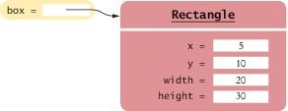
Object
When a variable is an object, its value is stored via the address/reference to the memory slot
Example: box is an object of the Rectangle class, with top left corner at (5, 10), width 20, length 30:
See Fig. 19 on p. 57 – Be careful

Slide 38
Using Graphics classes

Slide 39
The Color class
Must import java.awt.Color;
Google “java api” and click on the Color class to see the documentation for it
Some default colors are Color.BLACK, Color.ORANGE
There are 13 default colors: Color.BLACK ... Color.YELLOW
Java is case-sensitive, so both Color.BLACK and Color.black refer to the black color, but it is better to use the upper-case name, which follows the naming convention for “constants”

Slide 40
The Color class (cont.)
An object of the Color class is composed of 3 pieces of info: red, green, blue, each of which has value 0-255, referred to as RGB
To “create” color from scratch, call Color(int r, int g, int b)with the new operator:
Color color1 = new Color(255, 0, 0); // is Color.RED
Color color2 = new Color(200, 150, 180); //purplish
Color color3 = new Color(255, 255, 255); // is Color.WHITE

Slide 41
The Color class (cont.)
To “create” an opaque color from scratch, call Color(int r, int g, int b, int a) with the new operator, where 4th parameter a, with value 0 – 255, determines how opaque it is:
Color color4 = new Color(255, 255, 255, 200);

Slide 42
The Rectangle class (cont.)
Must import java.awt.Rectangle;
Create a rectangle by calling Rectangle(int x, int y, int width, int height), where x and y are top-left corner:
There are also other Rectangle constructors – see Java API
Some common methods are: grow, setSize, setLocation, getX, getY, getWidth, getHeight, translate
If you have 2 shapes of the same size but at different locations (like 2 windows in a house), create one Rectangle object, draw it, translate it, and draw it again
Rectangle box1 = new Rectangle(5, 10, 200, 300);

Slide 43
The Ellipse.Double class
Must import java.awt.geom.Ellipse2D;
Create an ellipse by calling Ellipse2D.Double(double x, double y, double w, double h), where x & y are top-left corner and w & h are width & height:
There is also another Ellipse2D.Double constructor – see Java API
Some common methods are similar to those of Rectangle
Ellipse2D.Double oval1 = new Ellipse2D.Double(150, 250, 100, 50);

Slide 44
The Line.Double class (cont.)
Must import java.awt.geom.Line2D.Double;
Create a line by calling Line2D.Double(double x1, double y1, double x2, double y2), where the parameters are the coordinates of the 2 endpoints:
Line2D.Double aLine = new Line2D.Double(50, 100, 95, 75);

Slide 45
The Polygon class
Must import java.awt.Polygon;
Create a line by calling Polygon(int[] xpoints, int[] ypoints, int npoints), where the parameters are x-coordinates, y-coordinates, number of points:
Some common methods are: translate, addPoint – see Java API
int[] xCoords = {120, 140, 130};
int[] yCoords = {150, 190, 220};
Polygon aPoly = new Polygon(xCoords, yCoords, 3);

Slide 46
The Graphics2D class
Drawing is done in a subclass of JComponent
Must
import java.awt.Graphics;
import java.awt.Graphics2D;
import java. ; // for JComponent
Cast: Graphics2D g2 = (Graphics2D) g;

Slide 47
The Graphics2D class (cont.)
We will use g2 as the variable name for the object of Graphic2D in these examples
To draw a shape object named box, call g2.draw(box);
To fill a shape object named oval, call g2.fill(box);
To draw text, call g2.drawString(“9870", 50, 130);
What is drawn/filled before will be under those drawn/filled after; e.g., if 2 concentric circles are filled and if the smaller circle is filled before the larger circle, then only the larger circle is visible

Slide 48
The Graphics2D class (cont.)
To draw or fill in certain color named aColor, set the color BEFORE drawing or filling, by calling g2.setColor(aColor);
To draw with thickness 5, set the thickness BEFORE drawing by calling g2.setStroke(new BasicStroke(5));
To use BasicStroke, must import java.awt.BasicStroke;
Note that the color & thickness are used until the next setting

Slide 49
Using the Random class

Slide 50
The Random class
Must import java.util.Random;
To create an object:
Random randGen = new Random(); // create object
To request an int between 0 and n, including 0 but not n, (where int n=6):
int result = randGen.nextInt(n); // get 1 to 6, inclusively
Adding 1 to result will simulate the roll of a 6-sided die:
int result = randGen.nextInt(n) + 1; // get 1 to 6, inclusively
Consult the API to get a random number of different types

Slide 51
THE END

